Slide 1
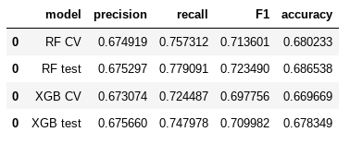
Machine Learning Model Outcomes
Executive summary report for the New York City Taxi and Limousine Commission
Prepared by Automatidata
The New York City Taxi & Limousine Commission (TLC) has partnered with the Automatidata data team to develop a machine learning model that predicts whether a NYC TLC taxi passenger will leave a generous tip.
After dismissing the initial modeling objective of predicting non-tippers due to ethical concerns, the focus shifted to predicting “generous” tippers—passengers who tip ≥ 20%. This approach was chosen to balance the potentially conflicting interests of taxi drivers and passengers.
The data team evaluated two distinct modeling architectures and compared their results. Both models demonstrated acceptable performance, with the random forest architecture achieving slightly better predictive accuracy. Consequently, the team recommends beta testing the model with taxi drivers to gather additional feedback.
Behind the data
The data team hypothesized that a trip’s itinerary, predicted fare amount, and time of day would have a strong enough relationship with tip amounts to accurately predict generous tipping.
After building and testing the models, the results confirmed that these factors significantly contribute to predicting tipping behavior. The model achieved an F1 score of 0.7235, indicating strong predictive performance.
Future model suggestions
Collect/add more granular driver and user-level data, including past tipping behavior.
Cluster with K-means and analyze the clusters to derive insights from the data
Results Summary
The resulting algorithm effectively predicts riders who are likely to be generous tippers, demonstrating reasonably strong performance across precision, recall, F1, and overall accuracy metrics.
The Automatidata data team recommends consulting with the New York City Taxi and Limousine Commission to share the model results and propose using the model as an indicator of tip amount. However, to achieve significant improvements in model performance, additional data collection and analysis would be necessary.

